Slide 1
Lecture 2: Problem Solving using
State Space Representation
CS 271: Fall, 1006

Slide 2
Overview
Intelligent agents: problem solving as search
Search consists of
  state space
  operators
  start state
  goal states
The search graph
A Search Tree is an effective way to represent the search process
There are a variety of search algorithms, including
  Depth-First Search
  Breadth-First Search
  Others which use heuristic knowledge (in future lectures)

Slide 3
Problem-Solving Agents
Intelligent agents can solve problems by searching a state-space
State-space Model
  the agent’s model of the world
  usually a set of discrete states
  e.g., in driving, the states in the model could be towns/cities
Goal State(s)
  a goal is defined as a desirable state for an agent
  there may be many states which satisfy the goal test
    e.g., drive to a town with a ski-resort
  or just one state which satisfies the goal
    e.g., drive to Mammoth
Operators (actions, successor function)
  operators are legal actions which the agent can take to move from one state to another

Slide 4
Example: Romania
On holiday in Romania; currently in Arad.
Flight leaves tomorrow from Bucharest
Formulate goal:
  be in Bucharest
Formulate problem:
  states: various cities
  actions: drive between cities
Find solution:
  sequence of cities, e.g., Arad, Sibiu, Fagaras, Bucharest

Slide 5

Example: Romania

Slide 6
Problem types
Static / Dynamic
Previous problem was static: no attention to changes in environment
Observable / Partially Observable / Unobservable
Previous problem was observable: it knew its initial state.
Deterministic / Stochastic
Previous problem was deterministic: no new percepts
were necessary, we can predict the future perfectly
Discrete / continuous
Previous problem was discrete: we can enumerate all possibilities

Slide 7
State-Space
Problem Formulation
A problem is defined by four items:
initial state e.g., "at Arad“
actions or successor function S(x) = set of action–state pairs
  e.g., S(Arad) = {<Arad → Zerind, Zerind>, … }
goal test, (or goal state)
e.g., x = "at Bucharest”, Checkmate(x)
path cost (additive)
  e.g., sum of distances, number of actions executed, etc.
  c(x,a,y) is the step cost, assumed to be ≥ 0
A solution is a sequence of actions leading from the initial state to a goal state

Slide 8
Defining Search Problems
A statement of a Search problem has 4 components
  1. A set of states
  2. A set of “operators” which allow one to get from one state to another
  3. A start state S
  4. A set of possible goal states, or ways to test for goal states
  4a. Cost path
Search solution consists of
  a sequence of operators which transform S into a goal state G
Representing real problems in a search framework
  may be many ways to represent states and operators
  key idea: represent only the relevant aspects of the problem (abstraction)

Slide 9
Example: Formulation the Route Map Problem
Set of States
  individual cities
  e.g., Irvine, SF, Las Vegas, Reno, Boise, Phoenix, Denver
Operators
  freeway routes from one city to another
  e.g., Irvine to SF via 5, SF to Seattle, etc
Start State
  current city where we are, Irvine
Goal States
  set of cities we would like to be in
  e.g., cities which are closer than Irvine
Solution
  a specific goal city, e.g., Boise
  a sequence of operators which get us there,
    e.g., Irvine to SF via 5, SF to Reno via 80, etc

Slide 10
Abstraction
Process of removing irrelevant detail to create an abstract representation: ``high-level”, ignores irrelevant details
Definition of Abstraction:
Navigation Example: how do we define states and operators?
  First step is to abstract “the big picture”
    i.e., solve a map problem
    nodes = cities, links = freeways/roads (a high-level description)
    this description is an abstraction of the real problem
  Can later worry about details like freeway onramps, refueling, etc
Abstraction is critical for automated problem solving
  must create an approximate, simplified, model of the world for the computer to deal with: real-world is too detailed to model exactly
  good abstractions retain all important details

Slide 11
Robot block world
Given a set of block in a certain configuration,
Move the blocks into a goal configuration.
Example :
  (c,b,a) → (b,c,a)
A
A
Move (x,y)
B
C
C
B

Slide 12
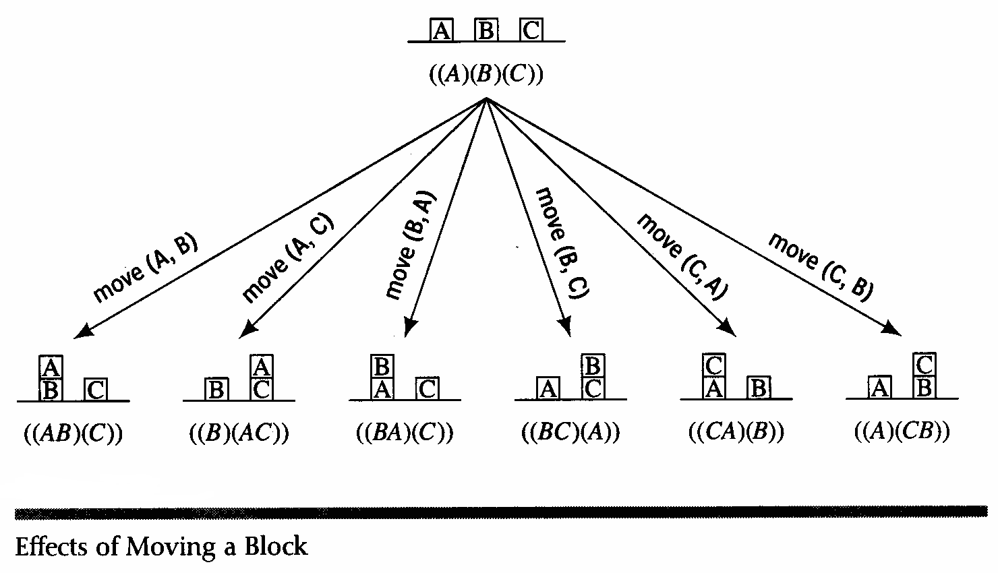
Operator Description

Slide 13
The state-space graph
Graphs:
  nodes, arcs, directed arcs, paths
Search graphs:
  States are nodes
  operators are directed arcs
  solution is a path from start to goal
Problem formulation:
  Give an abstract description of states, operators, initial state and goal state.
Problem solving:
  Generate a part of the search space that contains a solution

Slide 14
The Traveling Salesperson Problem
Find the shortest tour that visits all cities without visiting any city twice and return to starting point.
State: sequence of cities visited
S₀ = A
C
B
A
D
F
E

Slide 15


The Traveling Salesperson Problem
Find the shortest tour that visits all cities without visiting any city twice and return to starting point.
State: sequence of cities visited
S₀ = A
C
B
A
D
F
S_{G} = a complete tour
E

Slide 16

Example: 8-queen problem

Slide 17
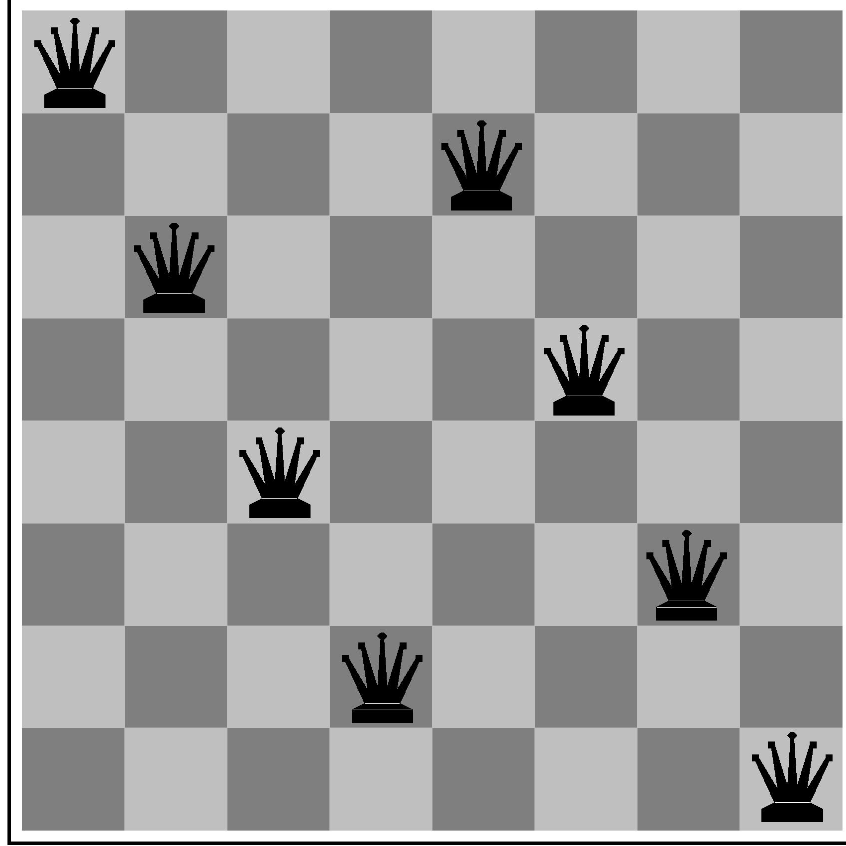
Example: 8-Queens
states? -any arrangement of n<=8 queens
-or arrangements of n<=8 queens in leftmost n
columns, 1 per column, such that no queen
attacks any other.
initial state? no queens on the board
actions? -add queen to any empty square
-or add queen to leftmost empty square such that it is not attacked by other queens.
goal test? 8 queens on the board, none attacked.
path cost? 1 per move

Slide 18
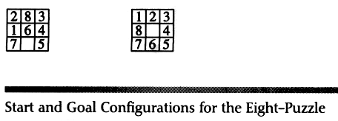
The sliding tile problem

Slide 19
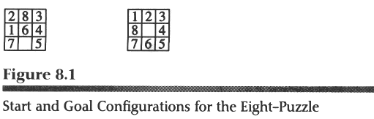
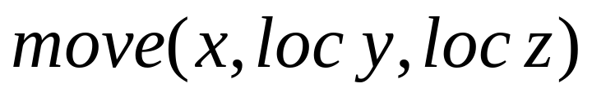
The Sliding Tile Problem
Up
Down
Left
Right

Slide 20
The “8-Puzzle” Problem
Start State
1
2
3
4
6
7
5
8
1
2
3
4
5
6
7
8
1
2
3
4
5
6
7
8
Goal State

Slide 21
Abstraction
Process of removing irrelevant detail to create an abstract representation: ``high-level”, ignores irrelevant details
Definition of Abstraction:
Navigation Example: how do we define states and operators?
  First step is to abstract “the big picture”
    i.e., solve a map problem
    nodes = cities, links = freeways/roads (a high-level description)
    this description is an abstraction of the real problem
  Can later worry about details like freeway onramps, refueling, etc
Abstraction is critical for automated problem solving
  must create an approximate, simplified, model of the world for the computer to deal with: real-world is too detailed to model exactly
  good abstractions retain all important details

Slide 22
Formulating Problems
Problem types
  Satisficing: 8-queen
  Optimizing: Traveling salesperson
Object sought
  board configuration,
  sequence of moves
  A strategy (contingency plan)
Satisficing leads to optimizing since “small is quick”
For traveling salesperson
  satisficing easy, optimizing hard
semi-optimizing:
  Find a good solution
In Russel and Norvig:
  signle-state, multiple states, contingency plans, exploration problems

Slide 23
Searching the State Space
States, operators, control strategies
The search space graph is implicit
The control strategy generates a small search tree.
Systematic search
  Do not leave any stone unturned
Efficiency
  Do not turn any stone more than once

Slide 24

Tree search example

Slide 25

Tree search example

Slide 26


Tree search example

Slide 27

Implementation: states vs. nodes
A state is a (representation of) a physical configuration
A node is a data structure constituting part of a search tree contains info such as: state, parent node, action, path cost g(x), depth
The Expand function creates new nodes, filling in the various fields and using the SuccessorFn of the problem to create the corresponding states.

Slide 28
Tree Representation of Searching a State Space
1. State Space
    nodes are states we can visit
    links are legal transitions between states
2. Search Tree:
  S is the root node
  The search algorithm searches by expanding leaf nodes
  Internal nodes are states the algorithm has already explored
  Leaves are potential goal nodes: the algorithm stops expanding once it finds the first goal node G
Key Concept
  Search trees are a data structure to represent how the search algorithm explores the state space, i.e.., they dynamically evolve as the search proceeds

Slide 29
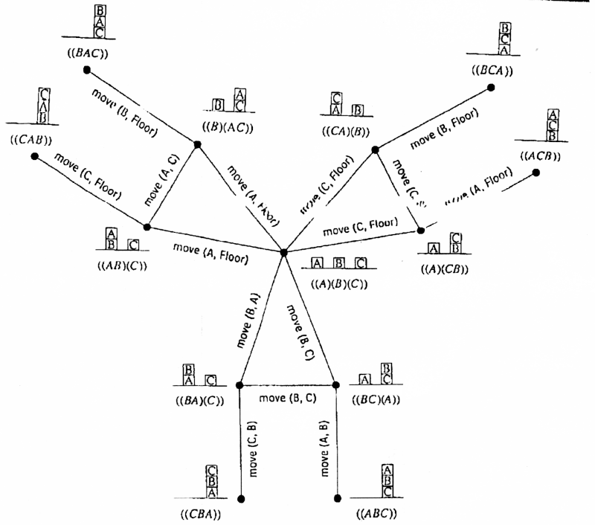
Explicit Graph

Slide 30
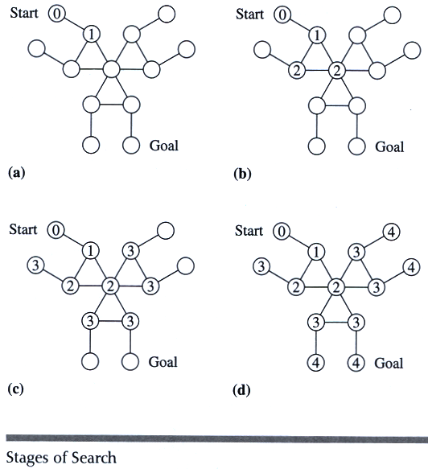
Breadth-first of explicit graph

Slide 31
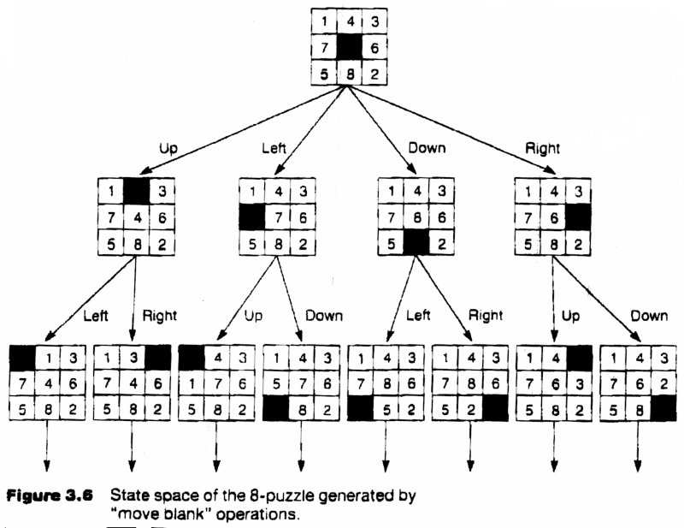
State space of the 8 puzzle problem

Slide 32
Why Search can be difficult
At the start of the search, the search algorithm does not know
  the size of the tree
  the shape of the tree
  the depth of the goal states
How big can a search tree be?
  say there is a constant branching factor b
  and one goal exists at depth d
  search tree which includes a goal can have
  b^{d} different branches in the tree (worst case)
Examples:
  b = 2, d = 10: b^{d} = 2¹⁰= 1024
  b = 10, d = 10: b^{d} = 10¹⁰= 10,000,000,000

Slide 33
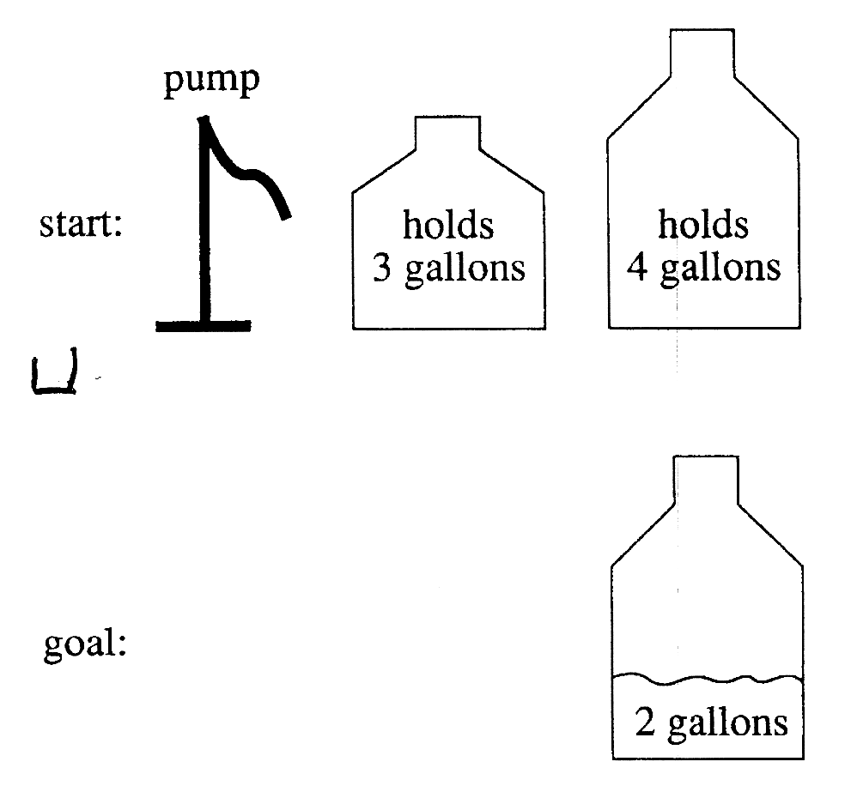
A Water Jug Problem

Slide 34
Puzzle-Solving as Search
You have a 4-gallon and a 3-gallon water jug
You have a faucet with an unlimited amount of water
You need to get exactly 2 gallons in 4-gallon jug
State representation: (x, y)
  x: Contents of four gallon
  y: Contents of three gallon
Start state: (0, 0)
Goal state (2, n)
Operators
  Fill 3-gallon from faucet, fill 4-gallon from faucet
  Fill 3-gallon from 4-gallon , fill 4-gallon from 3-gallon
  Empty 3-gallon into 4-gallon, empty 4-gallon into 3-gallon
  Dump 3-gallon down drain, dump 4-gallon down drain

Slide 35
Production Rules for the Water Jug Problem
Fill the 4-gallon jug
Fill the 3-gallon jug
Pour some water out of the 4-gallon jug
Pour some water out of the 3-gallon jug
Empty the 4-gallon jug on the ground
Empty the 3-gallon jug on the ground
Pour water from the 3-gallon jug into the 4-gallon jug until the 4-gallon jug is full
1 (x,y) → (4,y)
if x < 4
2 (x,y) → (x,3)
if y < 3
3 (x,y) → (x – d,y)
if x > 0
4 (x,y) → (x,y – d)
if x > 0
5 (x,y) → (0,y)
if x > 0
6 (x,y) → (x,0)
if y > 0
7 (x,y) → (4,y – (4 – x))
if x + y ≥ 4 and y > 0

Slide 36
The Water Jug Problem (cont’d)
8 (x,y) → (x – (3 – y),3)
if x + y ≥ 3 and x > 0
9 (x,y) → (x + y, 0)
if x + y ≤ 4 and y > 0
10 (x,y) → (0, x + y)
if x + y ≤ 3 and x > 0
11 (0,2) → (2,0)
12 (x,2) → (0,2)
Pour water from the 4-gallon jug into the 3-gallon jug until the 3-gallon jug is full
Pour all the water from the 3-gallon jug into the 4-gallon jug
Pour all the water from the 4-gallon jug into the 3-gallon jug
Pour the 2 gallons from the 3-gallon jug into the 4-gallon jug
Empty the 4-gallon jug on the ground

Slide 37
One Solution to the Water Jug Problem
Gallons in the 4-Gallon Jug | Gallons in the 3-Gallon Jug | Rule Applied
0 | 0 | 2
0 | 3 | 9
3 | 0 | 2
3 | 3 | 7
4 | 2 | 5 or 12
0 | 2 | 9 or 11
2 | 0

Slide 38
Summary
Intelligent agents can often be viewed as searching for problem solutions in a discrete state-space
Search consists of
  state space
  operators
  start state
  goal states
A Search Tree is an efficient way to represent a search
There are a variety of general search techniques, including
  Depth-First Search
  Breadth-First Search
  we will look at several others in the next few lectures
Assigned Reading: Nillson chapter 7 chapter 8
R&N Chapter 3

